Slide 1
Aspects of Military and Civilian Unmanned Aviation in the Australian Sphere of Influence

Slide 2
Sponsorship
And first a word from our sponsors

Slide 3
Wilmore Funeral Home
Notes:
Wilmore Funeral Home is looking for clients and we can get you a discount.
Now, to discuss something topical.

Slide 4
Drones
Civilian considerations
Military context
Fascinating military aviation history

Slide 5
Drones
Civilian considerations
Notes:
Cover general uses and rules around their use by anyone in the civilian area.

Slide 6
Definitions
Drone | Unmanned aircraft or ship that is guided remotely or autonomously.
UAV | Unmanned Aerial Vehicle, something that can fly without an onboard pilot.
UAS | Unmanned Aircraft Systems, includes person on the ground.
RPA | The entire system including aircraft, control station and wireless link.
Notes:
RPA Remotely Piloted Aircraft

Slide 7
CASA (Civil Aviation Safety Authority) rules
Ceiling height
Distance from people
Number of drones
Line of sight
Events
Notes:
Not above 120 m (400 ft)
30 m from people horizontally – except for those involved in operation/navigation of the drone
Operate only one drone at once
Line of sight – visual by eyes, no device, screen, goggles
Must not fly over people – beaches, festivals, sporting events, busy roads, pedestrians on footpaths.
Non- controlled operate only if no aircraft operating in the area, can’t be in airport or on approach/departure paths

Slide 8
CASA rules
5.5 km from controlled airport
Non-controlled airports
Visibility
Day/night operation
Operate safely
Weight limit
Notes:
5.5 km applies to drones > 250 g
Non-controlled: can fly within 5.5 km, must land if become aware of manned aircraft nearby, not within airport and not in arrival/departure paths.
My experience at Archerfield.
Private property – not illegal, must be less than 2 kg, not used for commercial gain. Recording footage still lawful. Should seek permission.
Visibility – no fog or cloud
Operate at night – must have remotely piloted aircraft operator’s licence or remote pilot licence
Operate safely – no aerobatics, wind shear. Above 25 kg must have CASA approval.

Slide 9
CASA rules
Emergency operations
Meteorology
Privacy considerations and photography
Shooting drones down
Notes:
Emergency: road accidents, bushfires, police activity, S and R. Issues with public trying to help.
Wind, rain.
Not illegal to fly over private property. Photography. Privacy Act does not apply to individuals acting in a private capacity (coys with turnover >$3m). Law has not kept up e.g. stalking.

Slide 10
Commercial drone operation
Individual - hold remote pilot licence
Organisation - hold remote pilot operator certificate
Swarm technology
Notes:
Commercial use – must register, have remotely piloted aircraft operator’s certificate - licence
Record: 3,051 drones in China, used at US 2019 Super Bowl and President Biden’s victory speech in 2020. Very expensive.
Vivid in Sydney – special exemption for night, risk assessment, from a barge in 2022.
Use AI, RF tech, GPS etc. Can autonomously navigate through forests, uses IOT. Overall called swarm intelligence, very mathematical, based on ant, bee etc algorithms. One system called Galileo for automated flight systems.

Slide 11
Notes:
The drone record – Chinese space station.

Slide 12
Future civilian operating issues
Flight paths
Flight rules
Drone size
Altitude ceilings
Prohibited areas
Meteorology
Notes:
My experience at Archerfield
Futuristic drones carrying passengers.
Power lines, no line of sight
Endurance – battery vs fuel management in planes

Slide 13
Commercial operation in Logan
One of 4 in the world (Canberra, Helsinki, Christiansburg)
Owned by Alphabet (Google)
Deliver range of products
Altitude ceilings
Prohibited areas
Notes:
Christiansburg in Virginia.
Logan: Wing delivers to 19 suburbs (coffee, milk, KFC, restaurants, hardware, bakery products, medicine, beauty pdts)
Delivers food, medicine, parcels up to 1.2 kg.
Hovers around 7 m, package lowered by tether, automatically released. Recipient to stay 2 m away. If someone grabs tether it releases and drone goes back to base.

Slide 14
Commercial operation in Logan
Notes:
Cruise height 45 m, delivery height 7 m. low res B and W cameras.
Hybrid – fixed wing and helicopter, 104 kph, 1.3 m long, 1 m wingspan, backup batteries, multiple rotors, multiple nav systems (4G, GPS). Fully automated flight path.

Slide 15
Drones
Military context
Notes:
Uses: reconnaissance, surveillance, electronic warfare, strike missions, target acquisition, communications relay, battlefield damage assessment, S and R.
Range in size from 1 kg to over 600 kg. Can be in a back pack.
Speed: small 80 kph, to over 500 kph.
Sensors: High resolution cameras inc colour, IR thermal imaging
Munitions: Missiles, explosives, Hellfire missiles
Endurance: hour or so up to 2 weeks (HALE – High Altitude long endurance drones, wing span 60 m)
Power plants: battery to internal combustion (Oz coy, Quickstep)

Slide 16
Notes:
Venezuelan President Maduro

Slide 17
Notes:
Slaughter bots. Professor of computer science at Berkeley. The 3 g of explosive concept tested by Swiss govt centre - worked.
Used today in Libya – made by Turkish coy STM

Slide 18
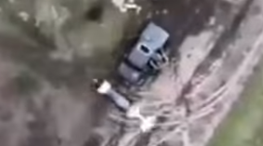
Drones in Ukraine
Notes:
Available in Oz – fishing on Fraser Island

Slide 19
Switchblade 300 drone
Light – 2.5 kg
Fits in backpack
Single use, unmanned
Launched from a tube
Notes:
Kamikaze/Suicide drones
Cruise 100 kph, 15 min, 10 km
Cameras, guidance systems, explosives, dive bomb target, has an operator.
Uses GPS and video for precise targeting
Can abort at any time, reassign different target.
Operator can adjust blast radius to take out driver but not passenger of vehicle.

Slide 20
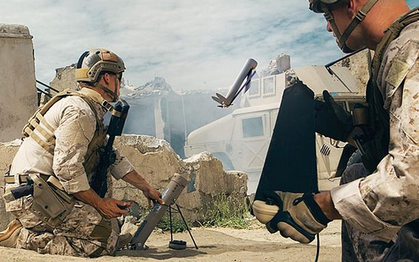
Switchblade 300 drone
Notes:
Cost $6,000
Hellfire $150,000
Only a matter of time before terrorist groups get them
Called Switchblade because wings spring out when launched.

Slide 21
Switchblade 600 drone
55 kg
Target armour - tanks
Single use, unmanned
Launched from a tube
Operator with tablet screen
Notes:
Range 40 km
Endurance 40 min

Slide 22
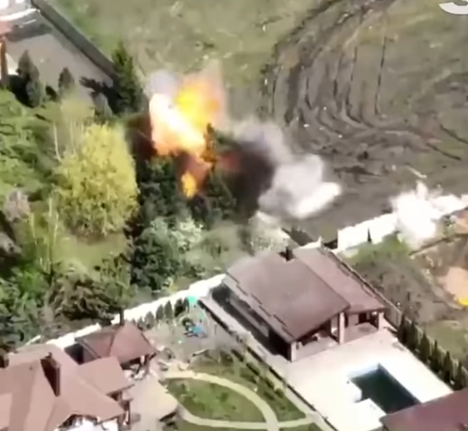
Notes:
Surgical precision aiming.

Slide 23
Bayraktar TB-2
Notes:
Built in Turkey. Small, slow, low altitude (can operate 18 – 27,000 ft), long endurance (27 hr), 3 blade prop, retractable UC, payload 150 kg, 70 – 120 kts
4 laser guided glide bombs, IR optics, anti-jammer antennae
Not fully stealthy, has low radar cross section
Has AI, deep learning algorithms
15 – 20 min to launch from a highway/road

Slide 24
How effective was the Bayraktar TB2?
Armoured fighting vehicles – 6
Towed artillery – 5
Surface to Air missile systems - 13
Helicopters – 10
Naval ships – 5
Vehicles – 24
Command posts - 3
Notes:
As at 27 Feb 22. All verified by video/photos
Naval ships: 4 patrol boats, 1 landing craft
Later article with tables of destroyed material is vastly higher. – some notes drones involved.

Slide 25
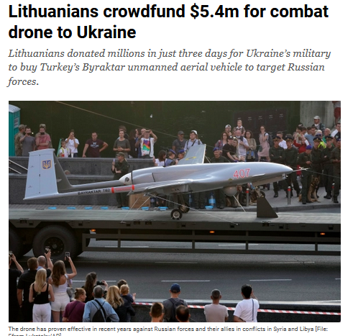

Slide 26
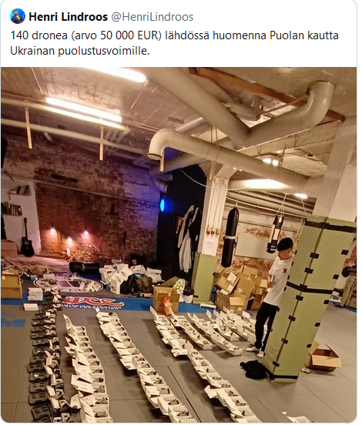
Notes:
Finland crowd funded 140 ultra portable sub 250 g drones, extra batteries and chargers – all charged.
Commercial off the shelf drones made in China.
Travelled to Ukraine via Poland. Bought at cost price.
Arranging more shipments.
30 min flying time, video and still cameras.

Slide 27
The future
Drones used widely
Phoenix Ghost drone
Kamikaze drone
Notes:
Phoenix: entered service in 2022, being supplied to Ukraine
Loiter for 6 hours
No photos available
Range could be about 280 km
Similar to Switchblade
China: Has 89 m ship designed to carry drone swarms, to use in Pacific region. Advanced control/AI software, small drone swarm flying through forest.

Slide 28
Commemorative Ukraine stamp
Notes:
The Moskva is depicted on a new Ukrainian stamp honouring the defenders of Snake Island who, when ordered to surrender, replied "Russian warship, go **** yourself" on 24th February.

Slide 29
Defence against drones
Civilian threats
Military use
Notes:
Airports, stadiums, sporting events, fixed infrastructure such as oil refineries, power generation, open events with VIP’s
Defence: Russia, China, terrorist groups etc. Passive and active applications.

Slide 30
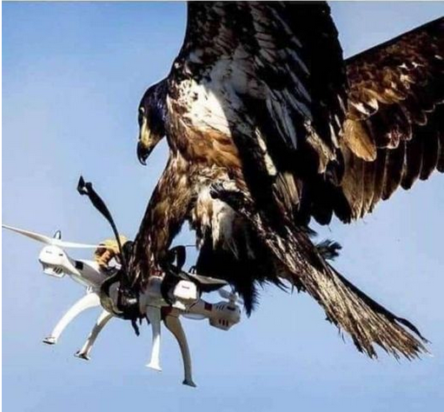
Bruce Davis – anti drone concept
Notes:
Convention Centre magpie

Slide 31
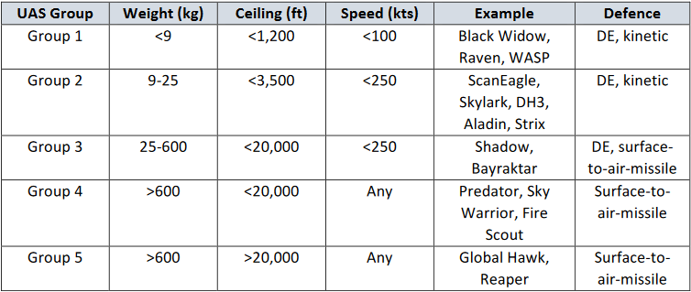
Drone classifications
Notes:
Gps 1-3, no deployed defences. Major impact on mil ops – tactical manoeuvre, ops, defending assets.
Gps 4, 5 strategic applications, counter by existing air defence systems.

Slide 32
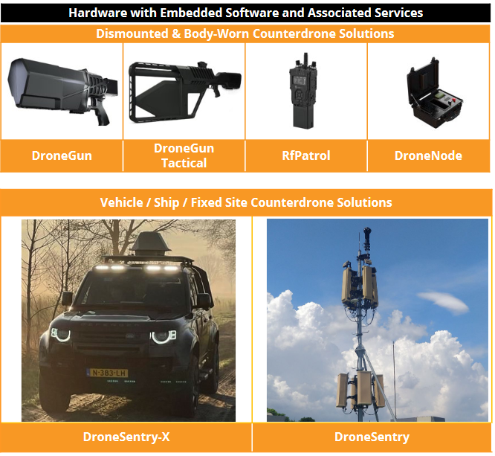
Droneshield – passive defence
Notes:
Uses AI as drones operate in densest part of RF spectrum – need to separate from noise – low false alarm rate. Use cloud computing techniques.
Remove ability of operator to control drone, can force them to go back to operator.
Small drones hard to differentiate from birds – use AI tracking algorithms with cameras, sensors to look at terrain. Funded by Oz D of D.
Have ECM tech AI in Signals Intelligence.
World leader, customers include Ukraine, US Defence, Middle East, South America, against drug cartels, Thales
Body worn, vehicle/ship mounted, fixed site.
Don’t have destructive capability.

Slide 33
Destruction of drones
Directed energy - lasers
Kinetic energy – guns, cannons

Slide 34
Electro Optic Systems – active defence
Laser directed energy source
Disabled drones in Group 1
Rate: 20 drones/min at > 1000 m
Notes:
DE System worked for Group 1, to extend testing to Gps 2 and 3.
EOS Titanis system: designed to disable drone and neutralise sensors, tested with live ammunition, take out 5-6 drones/min, too low to combat a swarm.
Need extreme accuracy assoc with radar detection, tracking, target selection, real time allocation of kinetic weapon.
Titanis/kinetic weapons worked with Gps 1 and 2; current Surface to Air missiles work with Gp 3 (25-600 kg) but too expensive.
Colocate DE and kinetic for complete coverage.

Slide 35
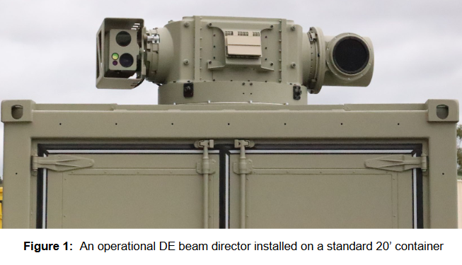

Slide 36
Ghost Bat
Notes:
Loyal Wingman now renamed as Ghost Bat, design to flight in 3 years.
Designed and built in Oz for RAAF, built in Melbourne, cutting edge tech, composites (787 tech).
First time Boeing has built a plane/drone outside USA.

Slide 37
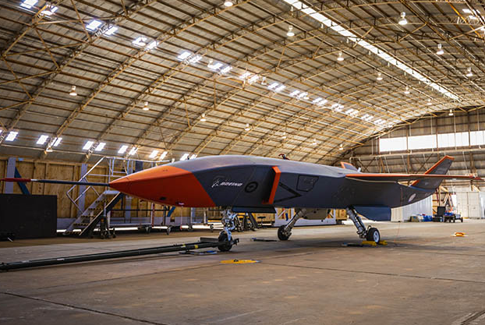
Notes:
For size, subsonic
Able to fly with fighters, stealth.
11.6 m, fit in 40 ft shipping container.
Range 3,700 km.

Slide 38
6th Generation fighters
May not have a pilot
Advanced digital capability
Integrate with fleets of satellite drones and ground sensors
Support swarms of drones
Early 2030’s
Notes:
UK and German/French designs to incorporate control of swarms of drones.

Slide 39
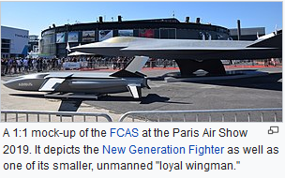
The future for fighters
Notes:
UK, Sweden, Italy 6th generation – Tempest. Future Combat Air System
Japan, Russia, India, China and US
Extremely likely there will be unmanned versions.
Include AI, data fusion, cyber warfare, battlefield integration, integrate with drones.
Directed energy e.g. laser weapons.

Slide 40
Fascinating military aviation history
Northrop Grumman Skunk Works

Slide 41
Fascinating military aviation history
Notes:
Skunkworks, Palmdale CA – just north of LA, Started in circus tent in WW2.
Changed their mode of operation: 12 months from initial concept to flight test to certification using digital engineering.
Kelly Johnson – 14 rules

Slide 42
U2
Notes:
U2, 70,000 ft ceiling. First flight 1955. General from Strategic Air Command walked out when he saw the design.
Gary Powers was shot down over Russia and Rudolf Anderson over Cuba.
No guns and no undercarriage to lower weight, notoriously difficult to fly, has to be stalled about 2’ above the runway to land due to ground air effect under wings (overloaded GA aircraft).
At max altitude they flew close to Vne (never exceed speed – structural damage) and only 9 km/hr above stall speed.
Had pogo wheels under the wings for takeoff and taxying and landed on it’s wing – Tip skid.
104 built, 3 pilots died.
A version is still flying.

Slide 43
SR-71 Blackbird
Notes:
The original name was RS-71 Blackbird but was changed to SR by military dude who altered what the US President was going to say and name stuck.
Only 32 built, never shot down, 12 crashed, 1 pilot died.
Titanium. Flew for 50 years, outrun missiles. Fly too high 85,000 ft + and max speed 4.000 km/h. Low radar cross section. Nose cones (moved 26 in) and subsonic air into engine. P & W designed to run on afterburner all the time.

Slide 44
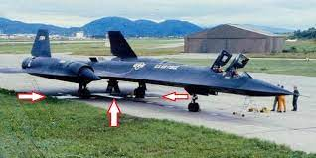
SR-71 Blackbird engineering
Notes:
Carried min fuel to take stress off tyres, refuel immediately after takeoff.

Slide 45
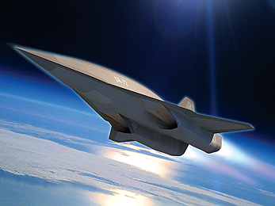
The future
Notes:
SR72 drone, hypersonic, Mach 6 – 7,400 kph
Intelligence, reconnaissance, strike missions.
Carry hypersonic weapons.
Did develop HTV-2 which flew to Mach 20 – 20,800 kph. Surface temp 1926 C. To study aerodynamics, thermal effects guidance, navigation control.
Hypersonic = >Mach 5 (about 6,174 kph)

Slide 46
F-117 Nighthawk
First stealth bomber
Used in initial Gulf War
Stealth technology
Unstable in all 3 principal axes (fly by wire)
Multi role ground attack
Radar cross section of 1.6 sq in
Notes:
1964 A Soviet mathematician published a theoretical paper showing that strength of radar returns is related to edge configurations and not size.
Depends on wing surface and edge but aircraft would become aerodynamically unstable. F-117 is subsonic, no afterburners (IR signature).
Model on a pole with radars. Had radar absorbing material on surfaces, angles deflected radar.
When an F-117 crashed in Sequoia National Forest in July 1986, killing the pilot and starting a fire, the Air Force established restricted airspace. Armed guards prohibited entry, including firefighters, and a helicopter gunship circled the site. All F-117 debris was replaced with remains of a F-101A Voodoo crash stored at Area 51
Some still flying.

Slide 47
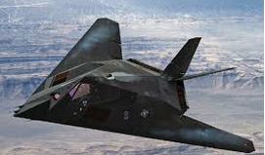
F-117 Nighthawk

Slide 48
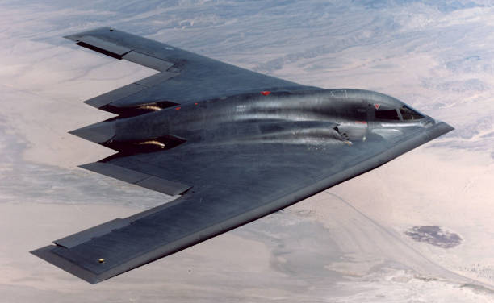
B-2 Bomber
Notes:
Centre of gravity and centre of lift, horizontal stabiliser on tail. One crashed on takeoff due to water getting into sensors.
20 built, first in 1989
Has toilet, bed, microwave. Range 11,000 km
Replacement: B-21 Raider, first have been built.

Slide 49
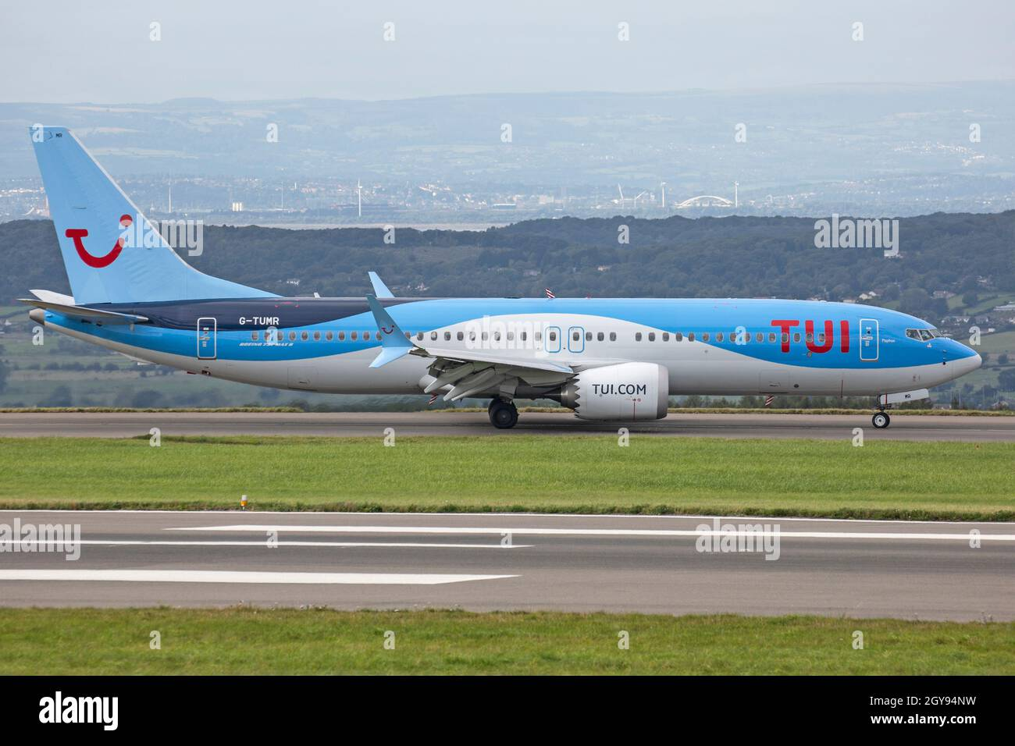
Boeing 737 MAX
Notes:
Boeing needed to upgrade the 737 to compete with Airbus. Corporates (money) in charge rather than engineers (safety). Modified 737 to avoid building new AC and needing certification. Moved engines forward. C of G changes with fuel burn etc. Diffult to control so MCAS Maneuvering Characteristics Augmentation System for trim. Made changes after FAA approval, relied on a single sensor (AoA), there were 2 but didn’t expect them both to agree, failure would generate corrective nosedive just after takeoff. No reference to MCAS in flight manuals to minimise pilot training. There was a switch that could turn it off.
Still ony 2 sensors – often 3, if an issue with one it is disregarded. Lion Air Ethiopian Airlines.
To pay $2.5 bn to airlines and families, $243 m criminal penalty and criminal charges dropped in 3 years if compensation paid. Reason: Boeing is huge Defence contractor and prohibited from future contracts.

Slide 50
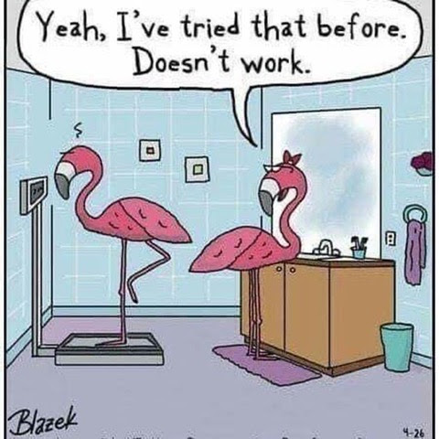
The End

